Slide 1
CSS OUTLINES

Slide 2
OUTLINES
Outlines are very similar to borders, but there are few major differences as well:
An outline does not take up space.
Outlines do not have to be rectangular.
Outline is always the same on all sides; you cannot specify different values for different sides of an element.
NOTE: The outline properties are not supported by IE 6 or Netscape 7.

Slide 3
OUTLINES
You can set the following outline properties using CSS.
The outline-width property is used to set the width of the outline.
The outline-style property is used to set the line style for the outline.
The outline-color property is used to set the color of the outline.
The outline property is used to set all the above three properties in a single statement.

Slide 4
The outline-width Property
The outline-width property specifies the width of the outline to be added to the box. Its value should be a length or one of the values thin, medium, or thick, just like the border-width attribute.
A width of zero pixels means no outline.
Here is an example:

Slide 5
The outline-width Property
<p style="outline-width:thin; outline-style:solid;">
This text is having thin outline.
</p>
<br />
<p style="outline-width:thick; outline-style:solid;">
This text is having thick outline.
</p>

Slide 6
The outline-width Property
<br />
<p style="outline-width:5px; outline-style:solid;">
This text is having 5x outline.
</p>

Slide 7
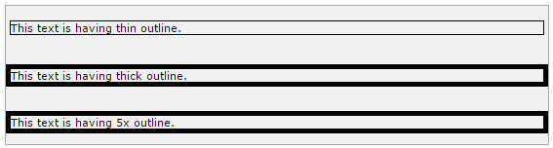
The outline-width Property
It will produce the following result:

Slide 8
The outline-style Property
The outline-style property specifies the style for the line (solid, dotted, or dashed) that goes around an element.
It can take one of the following values:
none: No border. (Equivalent of outline-width:0;)
solid: Outline is a single solid line.
dotted: Outline is a series of dots.
dashed: Outline is a series of short lines.

Slide 9
The outline-style Property
double: Outline is two solid lines.
groove: Outline looks as though it is carved into the page.
ridge: Outline looks the opposite of groove.
inset: Outline makes the box look like it is embedded in the page.
outset: Outline makes the box look like it is coming out of the canvas.
hidden: Same as none.

Slide 10
The outline-style Property
<p style="outline-width:thin; outline-style:solid;">
This text is having thin solid outline.
</p>
<br />
<p style="outline-width:thick; outline-style:dashed;">
This text is having thick dashed outline.
</p>

Slide 11
The outline-style Property
<br />
<p style="outline-width:5px;outline-style:dotted;">
This text is having 5x dotted outline.
</p>

Slide 12
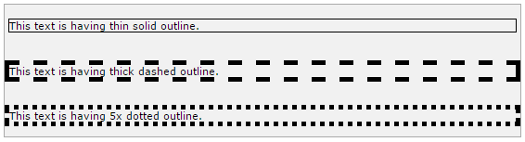
The outline-style Property
It will produce the following result:

Slide 13
The outline-color Property
The outline-color property allows you to specify the color of the outline.
Its value should either be a color name, a hex color, or an RGB value, as with the color and border-color properties.
Here is an example:

Slide 14
The outline-color Property
<p style="outline-width:thin; outline-style:solid;
outline-color:red">
This text is having thin solid red outline.
</p>
<br />
<p style="outline-width:thick; outline-style:dashed;
outline-color:#009900">
This text is having thick dashed green outline.
</p>

Slide 15
The outline-color Property
<br />
<p style="outline-width:5px;outline-style:dotted;
outline-color:rgb(13,33,232)">
This text is having 5x dotted blue outline.
</p>

Slide 16
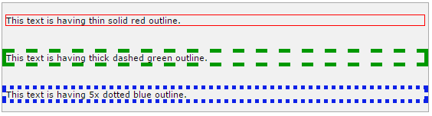
The outline-color Property
It will produce the following result:

Slide 17
The Outline Property
The outline property is a shorthand property that allows you to specify values for any of the three properties discussed previously in any order but in a single statement.
Here is an example:

Slide 18
The Outline Property
<p style="outline:thin solid red;">
This text is having thin solid red outline.
</p>
<br />
<p style="outline:thick dashed #009900;">
This text is having thick dashed green outline.
</p>

Slide 19
The Outline Property
<br />
<p style="outline:5px dotted rgb(13,33,232);">
This text is having 5x dotted blue outline.
</p>

Slide 20
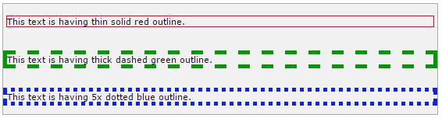
The Outline Property
It will produce the following result:

Slide 21
DIMENSION
You have seen the border that surrounds every box i.e. element, the padding that can appear inside each box, and the margin that can go around them.
Now, we will learn how to change the dimensions of boxes.

Slide 22
DIMENSION
We have the following properties that allow you to control the dimensions of a box.
The height property is used to set the height of a box.
The width property is used to set the width of a box.
The line-height property is used to set the height of a line of text.
The max-height property is used to set a maximum height that a box can be.

Slide 23
DIMENSION
The min-height property is used to set the minimum height that a box can be.
The max-width property is used to set the maximum width that a box can be.
The min-width property is used to set the minimum width that a box can be.

Slide 24
The Height and Width Properties
The height and width properties allow you to set the height and width for boxes.
They can take values of a length, a percentage, or the keyword auto.
Here is an example:

Slide 25
The Height and Width Properties
<p style="width:400px; height:100px;border:1px solid red;
padding:5px; margin:10px;">
This paragraph is 400pixels wide and 100 pixels high
</p>

Slide 26
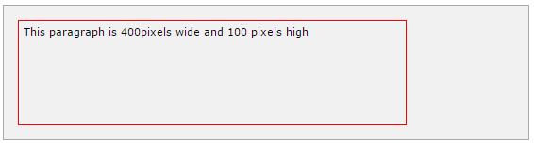
The Height and Width Properties
It will produce the following result:

Slide 27
The line-height Property
The line-height property allows you to increase the space between lines of text.
The value of the line-height property can be a number, a length, or a percentage.
Here is an example:

Slide 28
The line-height Property
<p style="width:400px; height:100px;border:1px solid red;
padding:5px; margin:10px;line-height:30px;">
This paragraph is 400pixels wide and 100 pixels high
and here line height is 30pixels.This paragraph is 400 pixels
wide and 100 pixels high and here line height is 30pixels.
</p>

Slide 29
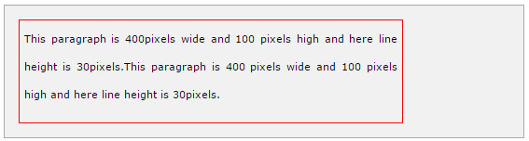
The line-height Property
It will produce the following result:

Slide 30
The max-height Property
The max-height property allows you to specify the maximum height of a box.
The value of the max-height property can be a number, a length, or a percentage.
NOTE: This property does not work in either Netscape 7 or IE 6.
Here is an example:

Slide 31
The max-height Property
<p style="width:400px; max-height:10px;border:1px solid red;
padding:5px; margin:10px;">
This paragraph is 400px wide and max height is 10px
This paragraph is 400px wide and max height is 10px
This paragraph is 400px wide and max height is 10px
This paragraph is 400px wide and max height is 10px
</p>
<img alt="logo" src="/images/css.gif" width="95" height="84" />

Slide 32
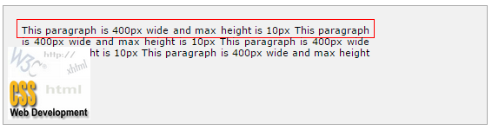
The max-height Property
It will produce the following result:

Slide 33
The min-height Property
The min-height property allows you to specify the minimum height of a box.
The value of the min-height property can be a number, a length, or a percentage.
NOTE: This property does not work in either Netscape 7 or IE 6.
Here is an example:

Slide 34
The min-height Property
<p style="width:400px; min-height:200px;border:1px solid red;
padding:5px; margin:10px;">
This paragraph is 400px wide and min height is 200px
This paragraph is 400px wide and min height is 200px
This paragraph is 400px wide and min height is 200px
This paragraph is 400px wide and min height is 200px
</p>
<img alt="logo" src="/images/css.gif" width="95" height="84" />

Slide 35
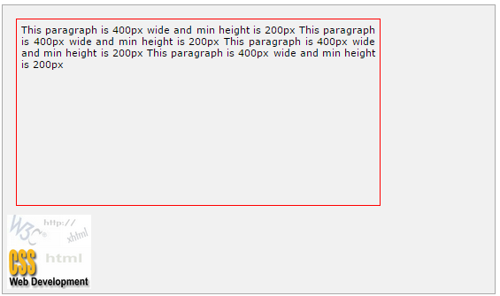
The min-height Property

Slide 36
The max-width Property
The max-width property allows you to specify the maximum width of a box.
The value of the max-width property can be a number, a length, or a percentage.
NOTE: This property does not work in either Netscape 7 or IE 6.
Here is an example:

Slide 37
The max-width Property
<p style="max-width:100px; height:200px;border:1px solid red;
padding:5px; margin:10px;">
This paragraph is 200px high and max width is 100px
This paragraph is 200px high and max width is 100px
This paragraph is 200px high and max width is 100px
This paragraph is 200px high and max width is 100px
This paragraph is 200px high and max width is 100px
</p>
<img alt="logo" src="/images/css.gif" width="95" height="84" />

Slide 38
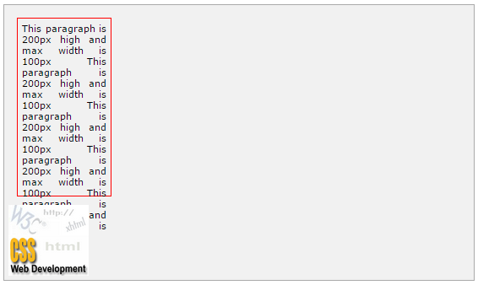
The max-width Property

Slide 39
The min-width Property
The min-width property allows you to specify the minimum width of a box.
The value of the min-width property can be a number, a length, or a percentage.
NOTE: This property does not work in either Netscape 7 or IE 6.
Here is an example:

Slide 40
The min-width Property
<p style="min-width:400px; height:100px;border:1px solid red;
padding:5px; margin:10px;">
This paragraph is 100px high and min width is 400px
This paragraph is 100px high and min width is 400px
This paragraph is 100px high and min width is 400px
This paragraph is 100px high and min width is 400px
This paragraph is 100px high and min width is 400px
</p>
<img alt="logo" src="/images/css.gif" width="95" height="84" />

Slide 41
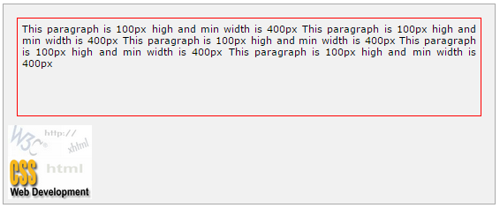
The min-width Property
It will produce the following result:

Slide 42
SCROLLBARS
There may be a case when an element's content might be larger than the amount of space allocated to it.
For example, the given width and height properties do not allow enough room to accommodate the content of the element.

Slide 43
SCROLLBARS
CSS provides a property called overflow, which tells the browser what to do if the box's contents is larger than the box itself.
This property can take one of the following values:

Slide 44
SCROLLBARS
visible
Allows the content to overflow the borders of its containing element.
hidden
The content of the nested element is simply cut off at the border of the containing element and no scrollbars is visible.

Slide 45
SCROLLBARS
scroll
The size of the containing element does not change, but the scrollbars are added to allow the user to scroll to see the content.
auto
The purpose is the same as scroll, but the scrollbar will be shown only if the content does overflow.

Slide 46
SCROLLBARS
<style type="text/css">
.scroll{
display:block;
border: 1px solid red;
padding:5px;
margin-top:5px;
width:300px;
height:50px;
overflow:scroll;
}

Slide 47
SCROLLBARS
.auto{
display:block;
border: 1px solid red;
padding:5px;
margin-top:5px;
width:300px;
height:50px;
overflow:auto;
}
</style>

Slide 48
SCROLLBARS
<p>Example of scroll value:</p>
<div class="scroll">
I am going to keep lot of content here just to show
you how scrollbars works if there is an overflow in
an element box. This provides your horizontal as well
as vertical scrollbars.
</div>
<br />

Slide 49
SCROLLBARS
<p>Example of auto value:</p>
<div class="auto">
I am going to keep lot of content here just to show
you how scrollbars works if there is an overflow in
an element box. This provides your horizontal as well
as vertical scrollbars.
</div>

Slide 50
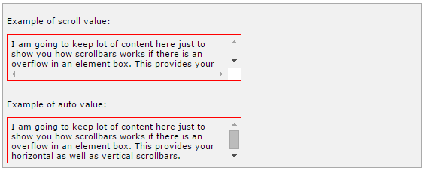
SCROLLBARS
It will produce the following result:

Slide 51
VISIBILITY
A property called visibility allows you to hide an element from view.
You can use this property along with JavaScript to create very complex menu and very complex webpage layouts.

Slide 52
VISIBILITY
You may choose to use the visibility property to hide error messages that are only displayed if the user needs to see them, or to hide answers to a quiz until the user selects an option.

Slide 53
VISIBILITY
NOTE: Remember that the source code will still contain whatever is in the invisible paragraph, so you should not use this to hide sensitive information such as credit card details or passwords.
The visibility property can take the values listed in the table that follows:

Slide 54
VISIBILITY
visible
The box and its contents are shown to the user.
hidden
The box and its content are made invisible, although they still affect the layout of the pag
collapse
This is for use only with dynamic table columns and row effects.

Slide 55
VISIBILITY
<p>
This paragraph should be visible in normal way.
</p>
<p style="visibility:hidden;">
This paragraph should not be visible.
</p>

Slide 56

VISIBILITY
It will produce the following result:

Slide 57
POSITIONING
CSS helps you to position your HTML element.
You can put any HTML element at whatever location you like.
You can specify whether you want the element positioned relative to its natural position in the page or absolute based on its parent element.
Now, we will see all the CSS positioning related properties with examples.

Slide 58
Relative Positioning
Relative positioning changes the position of the HTML element relative to where it normally appears. So "left:20" adds 20 pixels to the element's LEFT position.

Slide 59
Relative Positioning
You can use two values top and left along with the position property to move an HTML element anywhere in an HTML document.
Move Left - Use a negative value for left.
Move Right - Use a positive value for left.
Move Up - Use a negative value for top.
Move Down - Use a positive value for top.

Slide 60
Relative Positioning
NOTE: You can use the bottom or right values as well in the same way as top and left.
Here is an example:
<div style="position:relative;left:80px;top:2px;
background-color:yellow;">
This div has relative positioning.
</div>

Slide 61
Relative Positioning
It will produce the following result:

Slide 62
Absolute Positioning
An element with position: absolute is positioned at the specified coordinates relative to your screen top-left corner.
You can use two values top and left along with the position property to move an HTML element anywhere in HTML document.

Slide 63
Absolute Positioning
Move Left - Use a negative value for left.
Move Right - Use a positive value for left.
Move Up - Use a negative value for top.
Move Down - Use a positive value for top.
NOTE: You can use bottom or right values as well in the same way as top and left.
Here is an example:

Slide 64
Absolute Positioning
<div style="position:absolute;left:80px;top:20px;
background-color:yellow;">
This div has absolute positioning.
</div>

Slide 65
Fixed Positioning
Fixed positioning allows you to fix the position of an element to a particular spot on the page, regardless of scrolling.
Specified coordinates will be relative to the browser window.
You can use two values top and left along with the position property to move an HTML element anywhere in the HTML document.

Slide 66
Fixed Positioning
Move Left - Use a negative value for left.
Move Right - Use a positive value for left.
Move Up - Use a negative value for top.
Move Down - Use a positive value for top.
NOTE: You can use bottom or right values as well in the same way as top and left.
Here is an example:

Slide 67
Fixed Positioning
<div style="position:fixed;left:80px;top:20px;
background-color:yellow;">
This div has fixed positioning.
</div>

Slide 68
LAYERS
CSS gives you an opportunity to create layers of various divisions.
The CSS layers refer to applying the z-index property to elements that overlap with each other.
The z-index property is used along with the position property to create an effect of layers.

Slide 69
LAYERS
You can specify which element should come on top and which element should come at bottom.
A z-index property can help you to create more complex webpage layouts.
The following example shows how to create layers in CSS.

Slide 70
LAYERS
<div style="background-color:red;
width:300px;
height:100px;
position:relative;
top:10px;
left:80px;
z-index:2">
</div>

Slide 71
LAYERS
<div style="background-color:yellow;
width:300px;
height:100px;
position:relative;
top:-60px;
left:35px;
z-index:1;">
</div>

Slide 72
LAYERS
<div style="background-color:green;
width:300px;
height:100px;
position:relative;
top:-220px;
left:120px;
z-index:3;">
</div>

Slide 73
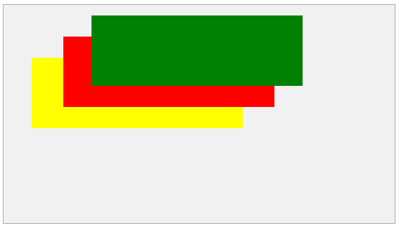
LAYERS
It will produce the following result:

